Slide 1
Java Script
Day 1

Slide 2
Objectives
What & Why JavaScript?
Client Side vs Server Side JavaScript
An brief overview of EcmaScript (ES5 & ES6/ES2015)
Logging output to browser console (console.log)
JS Variables & Constants
JS Variable hoisting
var and let keywords
const keyword
JS types
number, string, boolean
null & undefined
Arrays
JS Programming constructs
JS Operators
Conditionals and loops
Case control structures

Slide 3
Introduction to Java Script
Java Script first introduced in 1995 by Brendan Eich. Before it was called as Mocha. First version released in 10 days only.
In 1996, JS renamed as livescript and then Java script. Java script is nothing to do with Java but for marketing purpose, it renamed like this as Java was very popular programming language that time.
1997, This period was kind of revolution in Internet so there were need of any scripting language and JS was already used by many developer and it was very popular too . So in order to provide some standards for JS .Ecma institute designed some standards for Java scripts so it will be used with those standards. It was called as ES1.
In 2009, because of lots of disagreements and problems in 2009 ES5 has launched with lots of new features.
In 2015, (ECMAScript 2015) ES6 has launched with biggest update ever. It is also called as ES2015.
In 2016, ES7 or ES2016 has been released with some additional benefits and so on….ES2020

Slide 4
What is Java Script
We don’t have to worry about complex things like memory management.
JavaScript is a scripting or programming language that allows you to implement some functionality on web pages.
As we know that HTML pages are static pages but using JS we can implement some dynamic behavior in our HTML page.
Like perform some animation or data manipulation on our HTML page.
We can say JS is High level , Object Oriented programming / scripting language.
Instruct computer to do some action.
Based on object for storing data

Slide 5
JS Fundamental
In order to add JS in HTML document we will have to use <script> tag.
We can also create external .js file and later and embed with our HTML document.
In order to embed external .js file to our HTML page follow the syntax
<script src=“script.js”></script>

Slide 6
How does HTML, CSS, JS works?
HTML
<p></p>
CSS
P{
Height:20px
}
JS
P.hide()

Slide 7
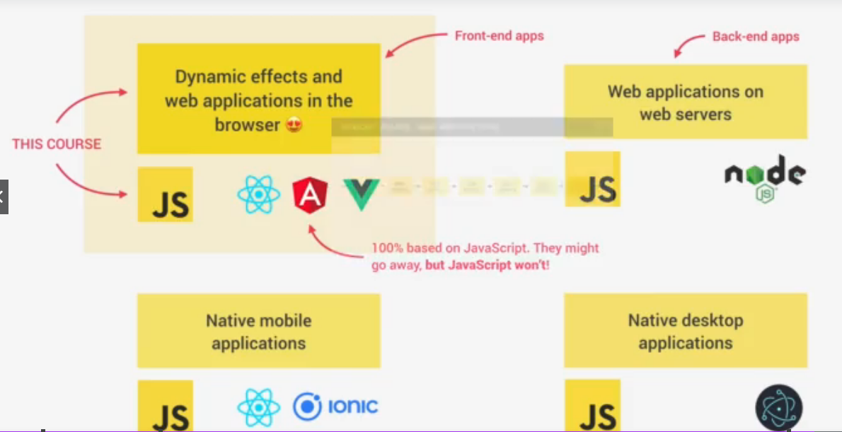
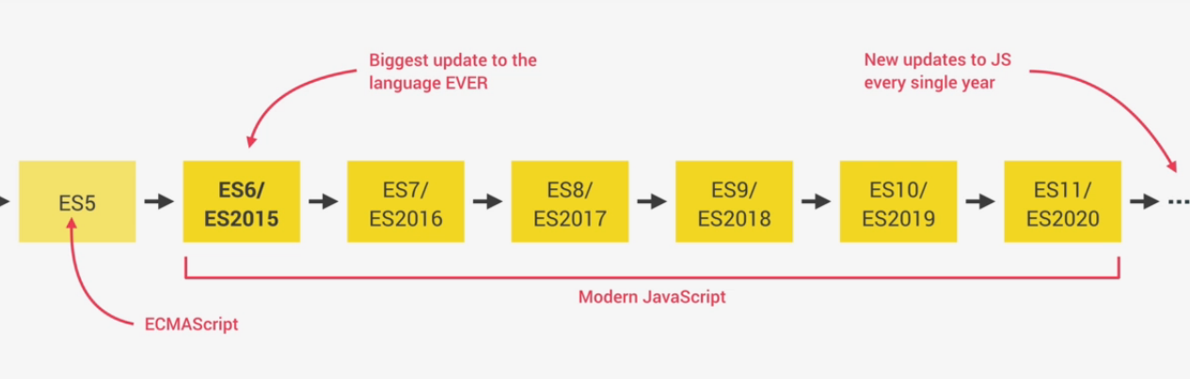
Use of Java Script

Slide 8
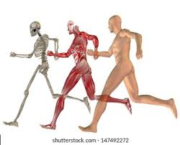
Why Java Script?
Analogy of HTML CSS and JS

Slide 9
Why Java Script?
JavaScript has evolved over the past 25 years to become a versatile and accessible programming language for working with web browsers. Developers use JavaScript to build complex interactive websites and browser games, and to connect servers to websites and web applications. Because of this versatility, it’s easy to see why this language is the most commonly used programming language in the world.
Whether you plan to specialize in front-end, back-end, or full-stack development, JavaScript is a crucial programming language for any web developer. Without JavaScript, we wouldn’t have the dynamic and interactive web pages that have become the standard user experience

Slide 10
Client Side vs Server Side JavaScript
Client-side scripting :
Client Side JavaScript (CSJS) is an extended version of JavaScript that enables the enhancement and manipulation of web pages at client browsers. In a browser environment , your code will have access to things provided only by the browser, like the document object for the current page, the window, functions like alert that pop up a message, etc. The main tasks of Client side JavaScript are validating input, animation, manipulating UI elements, applying styles, some calculations are done when you don't want the page to refresh so often. In web developing it's the browser, in the user's machine, that runs this code, and is mainly done in javascript . Also, this code must run in a variety of browsers.

Slide 11
Client Side vs Server Side JavaScript
Server-side scripting :
Server Side JavaScript (SSJS) is an extended version of JavaScript that enables back-end access to databases, file systems, and servers. Server side javascript, is javascript code running over a server local resources , it's just like C# or Java, but the syntax is based on JavaScript. A good example of this is Node.JS , with Node.JS you write javascript to program on the server side, and that code can be seen as normal C#, C, or any other server side language code.

Slide 12
Client Side vs Server Side JavaScript
JavaScript: Client side Vs. Server side
Client side programming includes any coding or computation or effects or animation or any sort of interaction your website performs with the user via browser . But server side programming is that which performs all the task in the server only . So the user is unaware of that. Few years ago JavaScript compilers were available only on the client machine (browsers). So java script was called as a client side scripting language. On the client side JavaScript is run by v8 engine (Google chrome). But now in the server side also JavaScript is used. The v8 engine (with some modifications to provide the server functionality) is also used in the servers to run js codes. So, in both cases the language is the same, only the environment is different.

Slide 13
An brief overview of EcmaScript (ES5 & ES6/ES2015)
ECMAScript(ES), ECMAScript is an simple standard for JavaScript and adding new features to JavaScript,
ECMAScript is a subset of JavaScript. JavaScript is basically ECMAScript at its core but builds upon it. Languages such as ActionScript, JavaScript, JScript all use ECMAScript as its core. As a comparison, AS/JS/JScript are 3 different cars, but they all use the same engine… each of their exteriors is different though, and there have been several modifications done to each to make it unique.
Let’s visit https://madasamy.medium.com/javascript-brief-history-and-ecmascript-es6-es7-es8-features-673973394df4 for more details

Slide 14
Demonstrate JS using Browser
Need to follow some basic steps to implement this.
Right click on browser
Click on inspect then click on console
Then start writing your java script code in browser only.

Slide 15
Add our first JS file in our web page
Create a folder and open it with VS code.
Create normal index.html file in respective project
There are two ways of implementing js in our project.
Internally → For internal js, simply add <script></script> and write your code in this tag
Externally → create a folder and add file_name.js file in folder and using script tag give reference of that file.

Slide 16
Values and Variables
Values → values is nothing but piece of data.
Example – Student’s name, Student’s address
While naming variable, we will have to follow some standard nomenclature
Example
Variable name couldn’t have js keywords like new, name
Variable name should follow camelCase
Some Variable like PI can declare in capital because it predefine
Variable name shouldn’t start with numbers.
Variable name shouldn’t consist special characters like &
Variable name should make some sense.

Slide 17
Guess correct variables
let new ="myname";
let studentName ="Bhushan";
let student_name ="John";
let student&name ="Abc";
let 3studentname ="Xyz";
let STUDENTNAME ="xyz";
let PI = 3.1415;
let $value = 75;

Slide 18
Data Types
Values
Object
Primitive
let address={
city : ’Nagpur’
state : ‘MH’
}
let city=‘Nagpur’
let state = ‘MH’

Slide 19
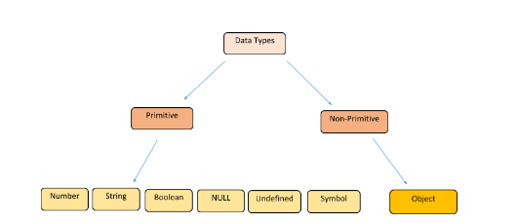
Data types

Slide 20
Data types
Numbers: A number data type can be an integer, a floating point value, an exponential value, a ‘NaN’ or a ‘Infinity’.
var a=250; // integer value
var b=25.5; // a number containing a decimal
var c = 10e4 // an exponential value which evaluates to 10*10000;
We can also create a number literal by using the Number() function:
var c = Number(5);
console.log(c); // This will return 5
We can create a number object using the ‘new’ operator and the Number() constructor:
var num1= new Number(5);
console.log(num1); // This will return 5
typeof(num1); // This will return ‘number’

Slide 21
Data types
String:
The string data type in JavaScript can be any group of characters enclosed by a single or double-quotes or by backticks.
var str1 = “This is a string1”; // This is a string primitive type or string literal
var str2= ‘This is a string2’;
var str3 = `This is a string3`;
Alternatively, we can use the String() function to create a new string.
var str4 = String(‘hi’); // This creates a string literal with value ‘hi’
The String() function is also used to convert a non-string value to a string.
String(4); // This statement will create a string ‘4’

Slide 22
Data types
Boolean:
The boolean data type has only two values, true and false. It is mostly used to check a logical condition. Thus Booleans are logical data types which can be used for comparison of two variables or to check a condition. The true and false implies a ‘yes’ for ‘true’ and a ‘no’ for ‘false in some places when we check a condition or the existence of a variable or a value.
When we check the data type of ‘true’ or ‘false’ using typeof operator, it returns a boolean.
typeof(true) // returns boolean
typeof(false) // returns boolean
We can create a new Boolean variable using the Boolean() function.
var check = Boolean(expression); // If the expression evaluates to true, the value of ‘check’ will be true or else it will be false.
var check = Boolean(a<b); // the expression evaluates to true, thus the value of check will be true.

Slide 23
Data types
Undefined:
Undefined data type means a variable that is not defined. The variable is declared but doesn’t contain any value.
var a;
console.log(a); // This will return undefined.
The variable ‘a’ has been declared but hasn’t been assigned a value yet.
We can assign a value to a:
a=5;
console.log(a); // This will return 5

Slide 24
Data types
Null:
The null in JavaScript is a data type that is represented by only one value, the ‘null’ itself. A null value means no value.
var a = null;
console.log(a); // This returns null
If we check the data type of a using the typeof operator, we get:
typeof(a); // This returns object
This means the type of a null value is an object, not null.

Slide 25
Data types
Array:
An array in JavaScript is an object data type. An array contains more than one value with a numerical index, where the index starts from 0. Thus it holds its value in a key-value pair.
var arr1= [1, 2, 3];
We cannot mutate or change the above array arr1.
Suppose we try to change its value.
arr1[0] =4;
console.log(arr1) // This will return the array [4, 2, 3]
typeof (arr1) // will return the data type ‘object’.
The array ‘arr1’ refers to the address in memory which contains the value [4, 2, 3].

Slide 26
Variable Hoisting in Javascript
Hoisting is JavaScript's default behavior of moving declarations to the top.
JavaScript Declarations are Hoisted
In JavaScript, a variable can be declared after it has been used.
In other words; a variable can be used before it has been declared.
Example:
x=5;
console.log(x);
var x;

Slide 27
Variable Hoisting in Javascript
Variable hoisting is one of the major feature of javascript, it allows a developer to understand Javascript's way of handling the variable's declaration. By bringing up all the variables’ declaration at the top of the functional/global block is called variable hoisting. This allows the user to use the variable before declaring it.
Example:
Hoisting of a Variable
Consider the a forementioned example and guess the output:
console.log("not declared but using variable age --> ", age)
var age = 10;

Slide 28
Variable Hoisting in Javascript
Declare Your Variables At the Top !
Hoisting is (to many developers) an unknown or overlooked behavior of JavaScript.
If a developer doesn't understand hoisting, programs may contain bugs (errors).
To avoid bugs, always declare all variables at the beginning of every scope.
Since this is how JavaScript interprets the code, it is always a good rule.

Slide 29
Let, Const, var
Var is oldest one way to declare variable
Const and let introduced from ES6
In this section we will see which keyword is use in which situation.
Let → let keyword is use when there are variable whose values can be changed later. We can declare variable with let keyword and can assign value later.
Const-> const is keyword is use to declare variable whose value won’t be changed at any point. When we will use const keyword to declare variable then we will must have to initialize values.
Var -> It’s best practice to avoid use of var keyword. Because it used in older version. Recently var is not commonly used.
Difference between var and let is ->let is block scope var is function scope.
https://www.programiz.com/javascript/let-vs-var

Slide 30
Operator
There are multiple operators are present in JS like other programming language.
We will see some example for implementing operators.

Slide 31
Operator
// Operators in JS
// const now = 2021;
// //Arithmetic operators
// const ageOFBhushan = now-1980;
// const ageOfSantosh = now-1982;
// console.log(ageOFBhushan +" - "+ageOfSantosh);
// let areaOfCircle = 3.14* 4*4;
// console.log(areaOfCircle);
//Assignments Operators
// let x=10+5;
// x +=10; //x = x+10;
// x *=4 ;
// console.log(x);
//comparision operators
// let num1 =10;
// let num2 =20;
// console.log(num1>num2);
//< > >= <= !=

Slide 32
Operator
//Assignments Operators
// let x=10+5;
// x +=10; //x = x+10;
// x *=4 ;
// console.log(x);
//comparision operators
// let num1 =10;
// let num2 =20;
// console.log(num1>num2);

Slide 33
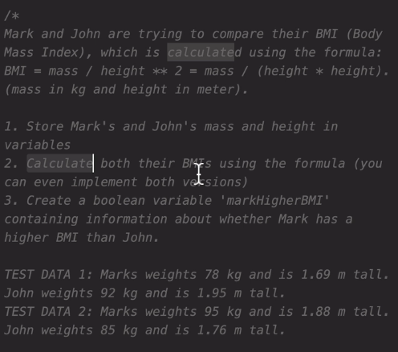
Problem statement

Slide 34
String and Templates
String are very important concept in all programming languages.
In java script we can combine String using + operator
We can also embed string literals using `${ }`
We will try this programmatically.

Slide 35
String and Templates
// String and Templates
// let empFirstName ="John";
// let empLastName = "Corner";
// // Manipulating string values
// //concatination string values using + symbol.
// let myString = empFirstName + " Is a very good Employee "+empLastName +" is his Last name";
// console.log(myString);
// console.log(empFirstName + " Is a very good Employee "+empLastName +" is his Last name");
// // String templates
// //in order to use templates in JS we will have to use `
// // Templates will be very useful for future implementation
// let newString = `${empFirstName} Is a good Employee and ${empLastName} is his last Name`;
// console.log(newString);

Slide 36
Decision Taking statement if else
Similar to other programming language JS also supports conditional statement.
Problem → Check whether any person can get driving license and if can’t then when can get it.

Slide 37
Decision Taking statement if else
// if else
// const age =15;
// if(age>18){
// console.log("You can get Driv. Lic.");
// }else{
// const yearleft =18 - age;
// console.log(`You are not elegible for Getting Driv. Lic
// you can apply after ${yearleft} years` );
// }

Slide 38
Decision Taking statement else if
//else if
// const age =18;
// if(age>18){
// console.log("You can get Driv. Lic.");
// }else if(age===18){
// console.log("You can wait for one month")
// }
// else{
// console.log("You are not elegible")
// }

Slide 39
Type conversion and coercion
In java script we can convert one type to others.
In Java script we can convert only few type like string to number and number to string , Boolean to string.

Slide 40
Type conversion and coercion
let yearOfBirth ='2000';
console.log(typeof (yearOfBirth));
console.log(Number(yearOfBirth))
let yob=Number(yearOfBirth)
console.log(typeof(yob));
console.log(2022-yearOfBirth);
let result=true
console.log(typeof(result));
let res=String(result);
console.log(typeof(res));
let stname="Bhushan";
let n = Number(stname);
console.log(n);

Slide 41
== & ===
== perform type coercion and it is call as loose checking
=== perform strict checking because it doesn’t perform coercion
‘18’ == 18 possible
18===18

Slide 42
Logical Operator
It is use to combine multiple conditions and then using logical operator we can get final output.
&&
||

Slide 43
Logical Operator
let age = 18;
if(age===18)
alert("Eligible");
// two logical operators
// && -- all conditions must be true
// || -- any condition is ture
let age=19 ;
let vision= 'bad'
if(age>18 || vision==='good')
{
console.log("You can apply for Pilot Lic.")
}
else{
console.log("You are not eligible ");
}

Slide 44
Switch Case
switch (choice){
case 'laptop':
console.log("You have selected Laptop");
break;
case 'mobile':
console.log("You have selected mobile");
break;
case 'homeappli':
console.log("You have selected homeappli");
break;
case 'Fashion':
console.log("You have selected Fashion");
break;
default:
console.log("Wrong Choice");
}

